Slide 1
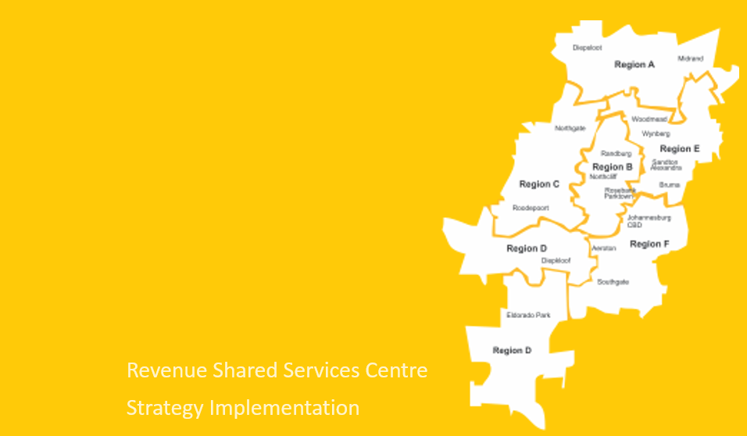
REGIONALISATION

Slide 2
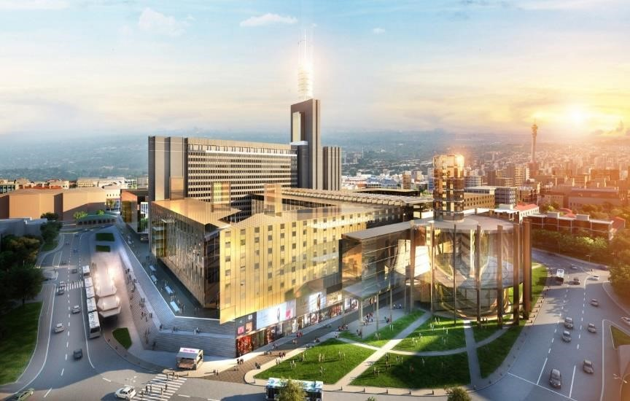
CONTENTS
Background
Stakeholders
Purpose
Account Management – Queries
Account Management - Debt
Benefits

Slide 3
RSSC Background
Revenue Shared Services Center (RSSC) is entrusted with the responsibility to generate bills for the services rendered (Property rates, refuse, Sewer, Water and Electricity), collection of the revenue and interaction with customers.
Transactional Billing
Invoicing & Statement Distribution
Query Resolution
Quality Assurance
System Support
Outbound
Logistics
Clearance
Refunds
Legal
Key Accounts
Staff Accounts
Joburg Connect
Customer Service Centers (57walk-in points)
Contact Center Support
Billing
Credit Management
Customer Interface

Slide 4
STAKEHOLDERS
RSSC
Municipal Entities
Customers
Development Planning
Property Branch
Councillors
Social Development
Citizens Relationship Urban Management (CRUM)
Ombudsman
Public Protector
Premier Office
Buya Mthetho

Slide 5
Purpose
The strategy intents is to improve efficiency and effectiveness of revenue collection with participation of :
Billing Back Office
Credit Management
Customer Interaction
MOE’s Technical support
GCIT
Social Services
Property Branch
Development Planning
The purpose is to introduce the Regionalisation project strategy implementation, effective 22nd February 2022:
Phase 1 (22/02 – 04/03 2022) Region B
Phase 2 (08/03 – 21/03 2022) Region E
Phase 3 (22/03 – 04/04 2022) Region A
Phase 4 ( 05/04 – 16/04 2022) Region C
Phase 5 (19/04 – 06/05 2022 ) Region F
Phase 6 ( 10/05 – 20/05 2022) Region D
Phase 7 ( 24/05 – 03/06 2022) Region

Slide 6
ACCOUNT MANAGEMENT - QUERIES
Queries on hand per age and account in arrears, contributed to the strategy implementation. The regionalization model will afford dedicated end to end account management per region.
RSSC will reside in one region for a period not less than two weeks and invite all regional customers to approach the city and obtained bill interpretation, further resolution and revenue collection upon acknowledgement of account interpretation. Credit Control will be effected for all over due accounts post customer engagement with audit following effected disconnections.
Queries @ Month End (Jan ’22) | 0 - 30 Days | 31 to 60 Days | 60 - 90 Days Queries | 90 Days + Queries | Value (Amount)
Non-Regionalized queries | 168 | 127 | 16 | 13 | R 23 490 760,68
Region A | 462 | 34 | 19 | 11 | R 94 481 988,91
Region B | 668 | 51 | 31 | 10 | R 102 689 005,62
Region C | 777 | 117 | 35 | 20 | R 136 857 921,85
Region D | 107 | 1 |  |  | R 16 666 258,73
Region E | 427 | 37 | 14 | 2 | R 85 497 905,04
Region F | 1 169 | 160 | 24 | 20 | R 459 134 664,78
Region G | 254 | 14 | 1 |  | R 23 553 190,77
Total Rand Value | 4 032 | 541 | 140 | 76 | R 942 371 696,38

Slide 7
Regionalisation Benefits
Customer Benefits
Customers alignment to their regional offices for focused service;
Regionalized Billing will enable customers an understanding of meter reading schedules.
Offer instant query resolution
Regionalisation Operational Benefits
Alignment of meter readings to geographic regions to improve efficiency, billing accuracy and collections;
Billing accuracy will improve and reduce customer complaints
Will provide the ability to measure performance per geographic area;
Enable instant credit control and collection

Slide 8

THANK YOU

